Slide 1
Product Line Decisions & Product Life cycle
.

Slide 2
Basic Concept
A product can be defined as a collection of physical, service and symbolic attributes which yield satisfaction or benefits to a user or buyer.
A product is a combination of physical attributes say, size and shape; and subjective attributes say image or "quality". A customer purchases on both dimensions.
The product involve several decisions for its formations as well as distribution to end consumer.

Slide 3

Definition
According to W. Alderson describes product “A Product is a set of tangible and intangible attributes, including packaging, color, price, manufacturer’s and retailer’s services, which the buyer may accept as offering satisfaction of wants or needs.”

Slide 4
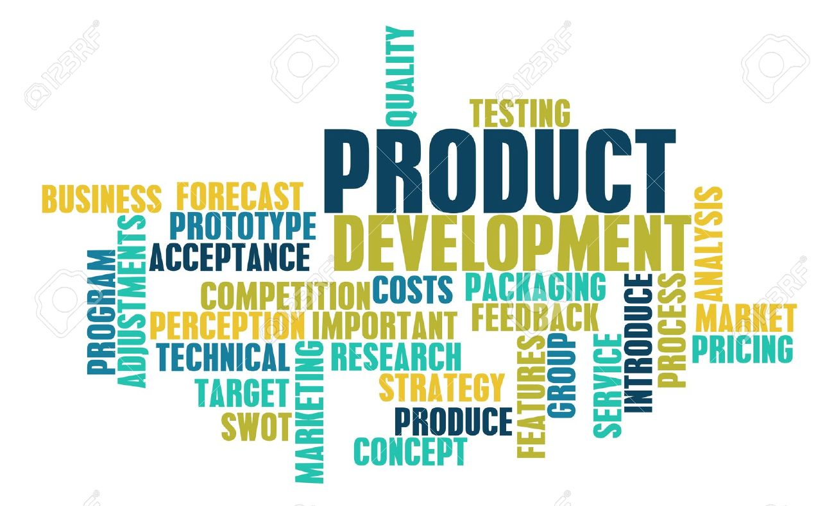
Characteristics of Product
Set of Tangible & Intangible attributes
Includes color, price, packaging and branding
Group of utilities
Designed and presented to satisfy some specific consumer needs

Slide 5
Characteristics of Product
Main aim is to provide maximum consumer satisfaction
Consumer satisfaction from product may be real or psychological in nature
Each brand in marketing is a separate product
It is first ‘P’ out of four Ps of marketing mix
Notes:
Typically, the marketing mix refers to the four Ps: product or service, its price, placement, and promotion.

Slide 6
Product Decisions
Marketing mix describes how a business uses and manipulates the 4ps to market their product.
Businesses employ different strategies when marketing products compared to services.
As a physical product, marketers need to consider packaging, labelling and branding involved in marketing the overall product.

Slide 7
Type Of Decisions
Product Design Decisions.
Production decisions.
When and Where to Launch decisions.
Product Mix And Product Line

Slide 8
Product Design Decision
Initial design
More unique design less competitors‘ hence more profitability
Uniqueness based on the technology.
Change in existing design
From Standardization to Adaptation
For Improving the current prospects of sales
Design decisions also culturally bound

Slide 9
Production Decisions
The key question is, can we ensure continuity of production and supply?
Decision may involve
Product manufacturing process
Batch flow line
Technology to use.
Product Quality

Slide 10
(Where to Launch)
Local products - seen as only suitable in one single market.
International products - seen as having extension potential into other markets.
Multinational products - products adapted to the perceived unique characteristics of national markets.
Global products - products designed to meet global segments.

Slide 11
Product Items, Lines, and Mixes
Product Item
A specific version of a product that can be designed as a distinct offering among an organization’s products.
Product Line
A group of closely-related product items. Categories of product
Product Mix
All products that an organization sells.

Slide 12
Product Mix Decisions
Product- mix is the total sum of products in the different product lines of a company. It is a group of similar and consistent products marketed by a company.
Dimensions of Product Mix-
Width of Product Mix – how many product lines a company has.
Depth of Product Mix – how many products are there in a each product line. It is measured by the sizes, colors and models offered within each product line.
Consistency of Product Mix – how closely related the product lines are in end use (Similarities in different product lines).
Inconsistency of Product Mix- It refers to heterogeneity of product lines of a company. A marketing company producing textiles, cement, chemicals and tires can be termed a company having inconsistency in product mix.

Slide 13
Gillette’s Product Lines & Mix
Width of the product mix
Blades and Writing
razors Toiletries instruments Lighters
Fusion – 5 blade
Mach 3 Turbo
Mach 3 Series Paper Mate Cricket
Sensor Adorn Flair S.T. Dupont
Trac II Toni S.T. Dupont Atra Right Guard
Swivel Silkience
Double-Edge Soft and Dri
Lady Gillette Foamy
Super Speed Dry Look
Twin Injector Dry Idea
Techmatic Brush Plus
Depth of the product lines

Slide 14
MAJOR PRODUCT MIX STRATEGIES
Expansion of Product Mix
Width - Mix extension.
Depth - Line extension.
Contraction of Product Mix
Width- Mix extension.
Depth - Line extension.
Alteration of Existing Products
Positioning the Product
Position is the image that the product projects in relation to competitive products and to other products marketed by the company.

Slide 15
What is a Product Line?
A product line is a broad group of products, intended for essentially similar uses and possessing reasonably similar physical characteristics.
A product line is that combination of products which;
Belongs to a single manufacturer
Shares similar Attributes
Serves the common general purpose but;
Targets different market segments

Slide 16
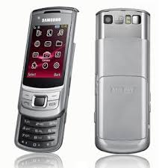

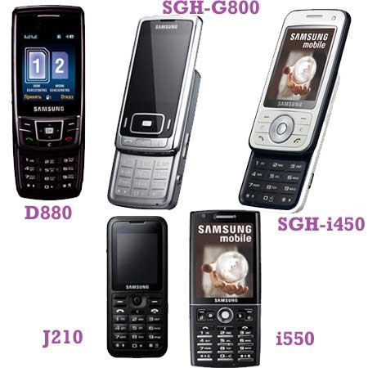


Samsung

Slide 17


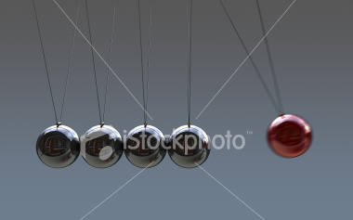
Why Product line decisions?
Provides better market access
Involves huge investment/disinvestment
Products have close mutual influence

Slide 18
Product Line Strategies

Slide 19
Expansion of product line
Process of adding more products to the line
Valid only if;
There is a well established brand arena & customers are accustomed to switch.
Competitor lacks a comparable product
Competitor have already expanded to the proposed area.

Slide 20
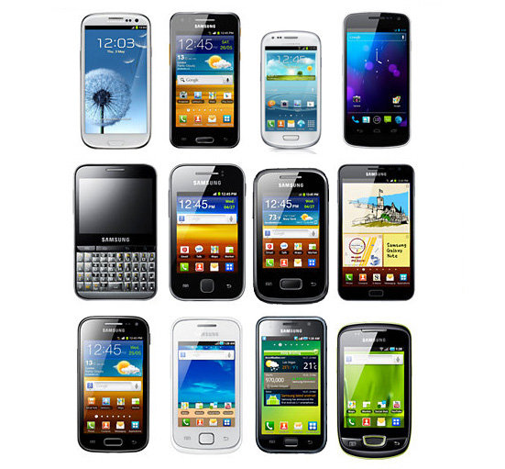


Slide 21
Contraction of the product line
Dropping a product from the line.
The reasons behind a drop may be;
Fine tuning the market performance
Eliminating a poor performing product
Uplifting a product with more potential
This is a much difficult task since much money is already been invested and hence products are allowed to linger on until they become a loss.

Slide 22
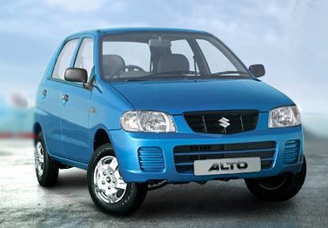
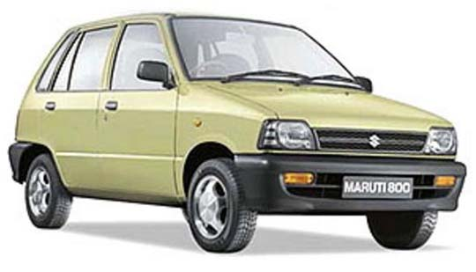
Out
In

Slide 23
Alteration of the existing products
An alteration may be in;
Design
Size
Colour
Texture
Flavour
Packaging
Advertising appeal

Slide 24
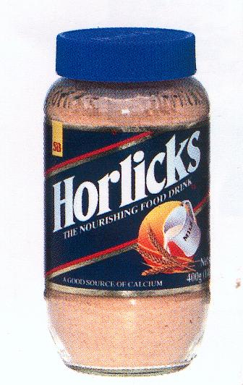
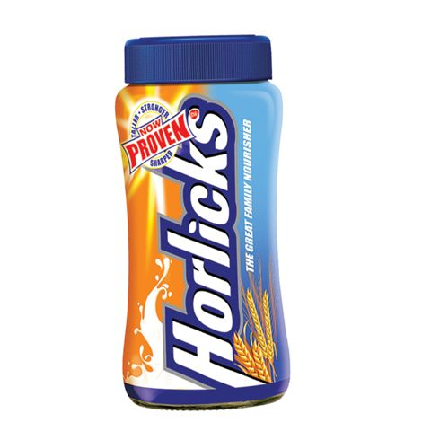

Slide 25
Developing new use for the existing products
This is intended to attract a new category of customers to the manufacturer without forming a new product.
Investments in R&D and Advertisement is required.

Slide 26
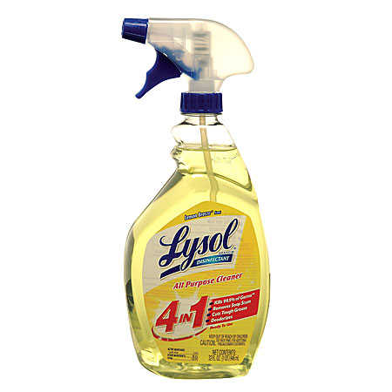
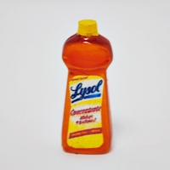

Slide 27
TRADING UP AND TRADING DOWN
Trading up: Adding a higher-priced, prestige product to a line in the hope of increasing the sales of existing lower-priced products.
Trading down: Adding a lower-priced item to a line of prestige products in the hopes that people who cannot afford the original product will want to buy the new one, because it carries some of the status of the higher-priced good.
Problems
May confuse buyers
Sales are at the expense of older products
May permanently harm company reputation

Slide 28
Trading Up
Adding a high priced prestigious product to the line so as to increase the sales of the existing low priced product.

Slide 29
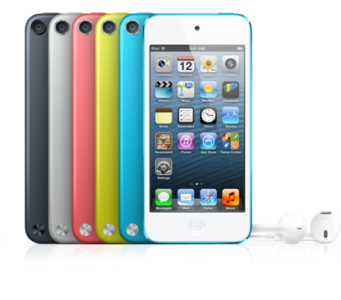
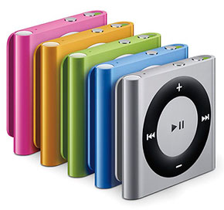
Rs. 8000 -Rs 9000
Rs. 2000 – Rs. 2500

Slide 30
Trading Down
Introducing a low priced product to the prestigious line so as to cater increased demand.

Slide 31
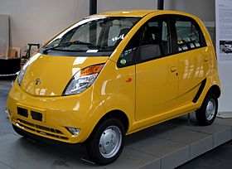

Slide 32
PRODUCT DIFFERENTIATION AND MARKET SEGMENTATION
Product differentiation: Developing and promoting an awareness of differences between one company's product and those of competitors
Market Segmentation: To develop different products each one suited to one or more segments of the market.

Slide 33
Factors influencing Product Line Decisions

Slide 34
Changes in market demand
Competitive action and reaction
Marketing Influences
Product influences
Financial Influences

Slide 35
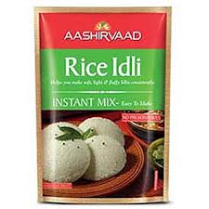

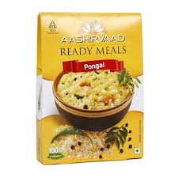
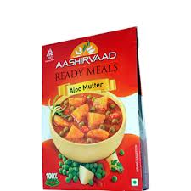
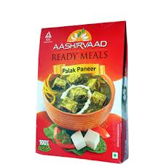
Changes in market demand

Slide 36

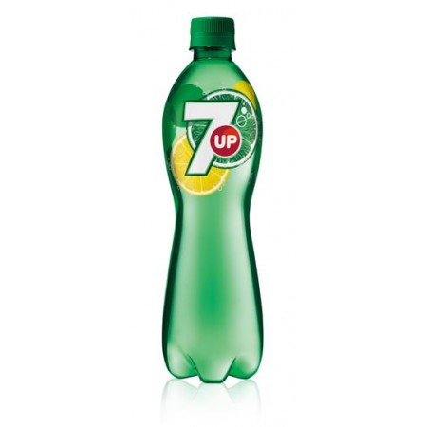
Competitive action and reaction
&

Slide 37
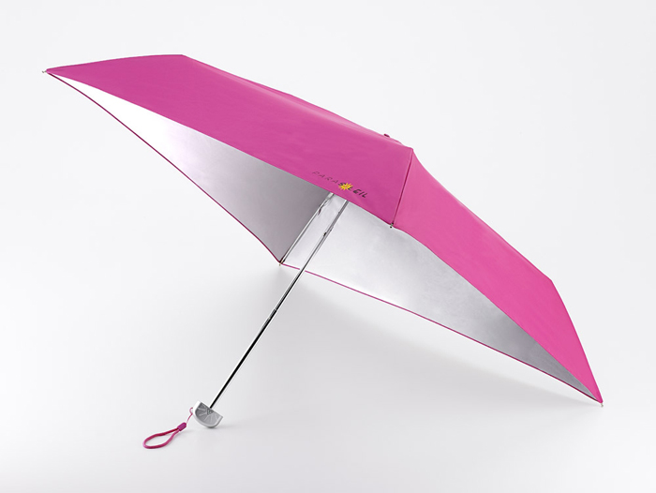
Marketing Influences

Slide 38
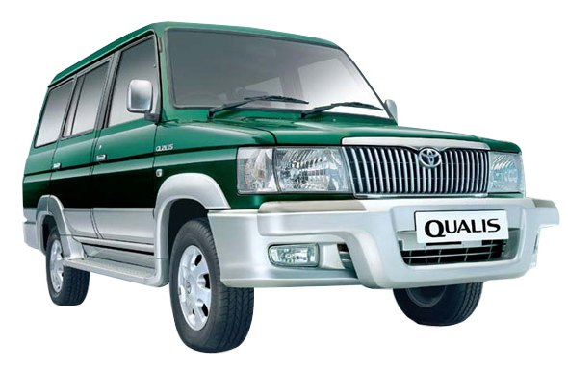
Financial Influences

Slide 39
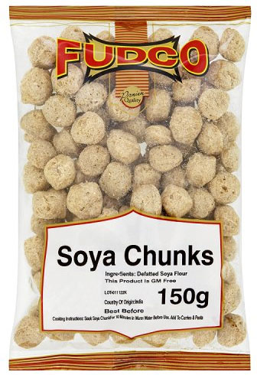
Product Influences

Slide 40
Concept of Product Life Cycle

Slide 41
The concept
Every product has a life cycle, just as in case of human beings.
The term first time used by Theodore Levitt in 1965 in Harvard Business Review article.
A Product after being introduced in to the market, goes through different stages which is categorised on the basis of product, profit, competition and market behaviours.
PLC is a concept which indicates various stages of product’s sales and history.

Slide 42
Definition
According to Philip Kotler “ The product life- cycle is an attempt to recognize distinct stages in the sales history of the product.”
According to Kollet, Blackwell Robeson, product life cycle is a “generalized model of sales and profit.”

Slide 43
Stages of Life Cycle
Introduction
Growth
Maturity
Saturation &
Decline

Slide 44
Introduction stage
Product is Introduced in the market for the first time.
Slow growth rate
Negative or low profits
Huge marketing expenses
No competition
Highly volatile in nature

Slide 45


Slide 46
Growth Stage
Sales rises at an increasing rate
Profitable returns from the market
Reduced promotional expenses
Hard work for the firm to establish dealerships & distribution outlets
Competitors starts to explore the market

Slide 47


Slide 48
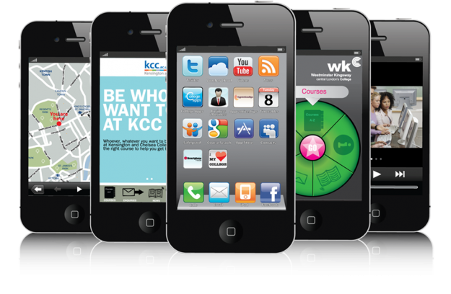

Slide 49
Maturity Stage
Sales are still increasing, but at a decreasing rate.
Severe competition
Profits fall in line with falling prices, which is unavoidable to retain market share.
Investments in promotional measures to differentiate the product
New distribution strategies & alliances

Slide 50
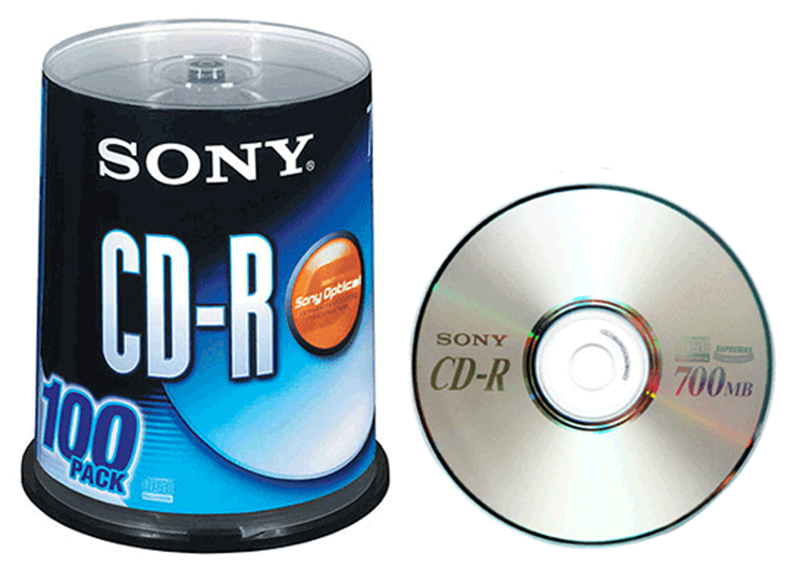

Slide 51


Slide 52
Saturation Stage
Sales are stable
Profits fall drastically
Competition is at the peak
Continued need for promotion to maintain sales
Firm has to plan product modifications

Slide 53
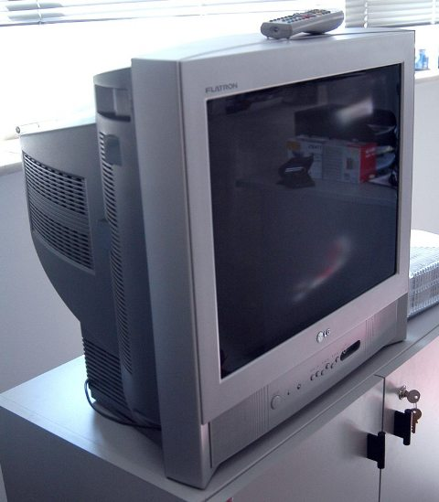

Slide 54
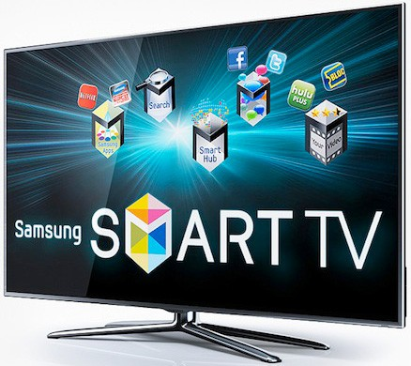
The old TV is getting replaced by..

Slide 55
Decline
Characterised by falling sales for the whole industry.
Prize cutting is continued and profit is at zero level.
Firm has to take a major strategic decision whether to continue with the product or abandon it.

Slide 56
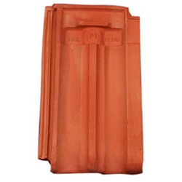

Slide 57
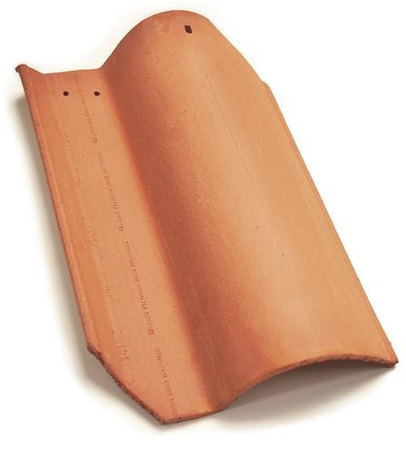

This old roofing tile industry is now switching to...

Slide 58
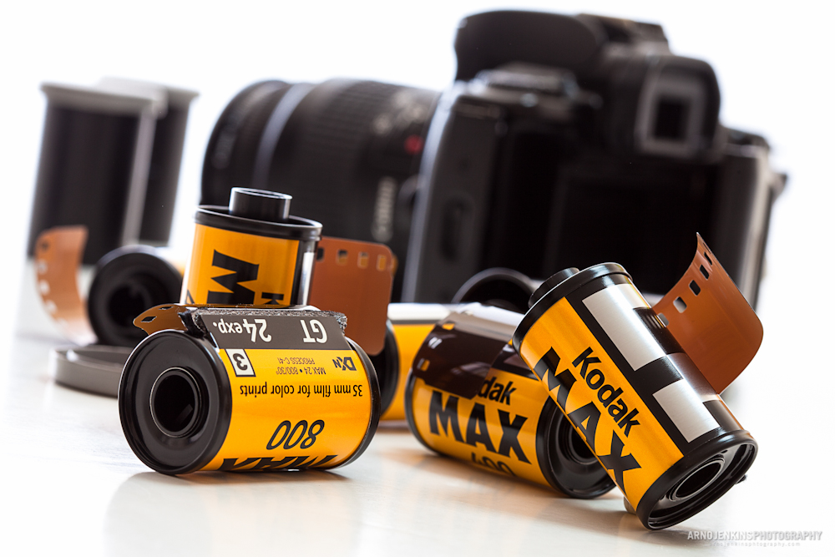
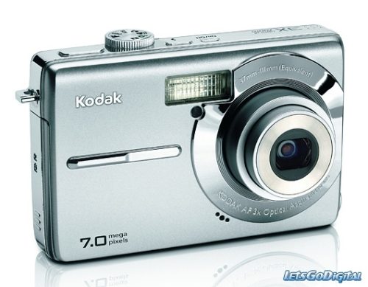
More examples for product replacement

Slide 59
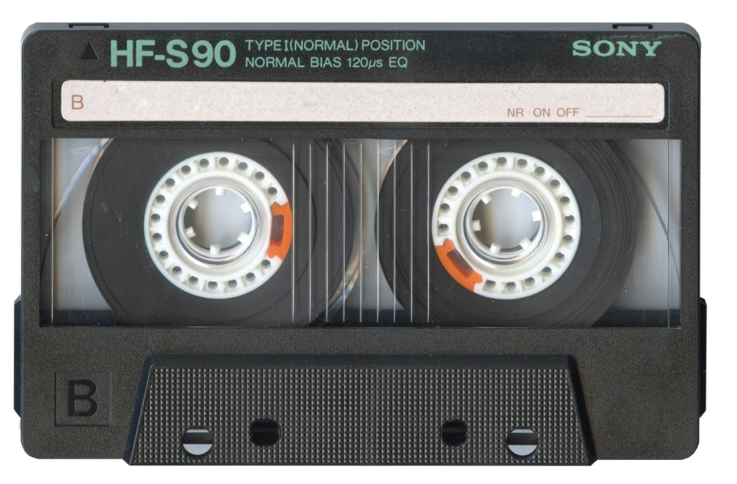
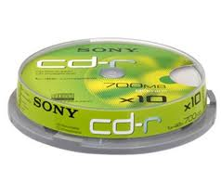
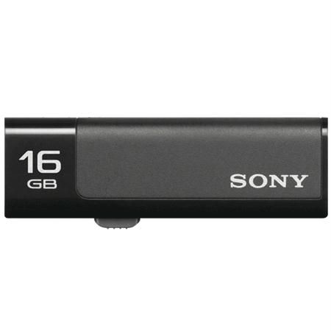

Slide 60
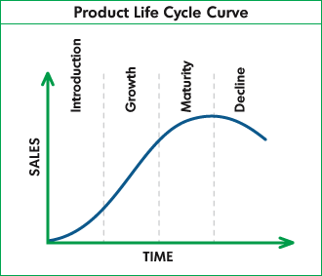
The PLC Graph

Slide 61
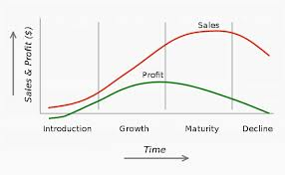
Graph with Profit curve

Slide 62
Conclusion
Every product has got a life cycle and every product will pass through the stage of decline someday.
But, through effective product line decisions and other strategies, we can extend its profitability period much longer to our benefits.

Slide 63

Thank You!!

